Slide 1
Optical Character Recognition with Auto segmentation

Slide 2
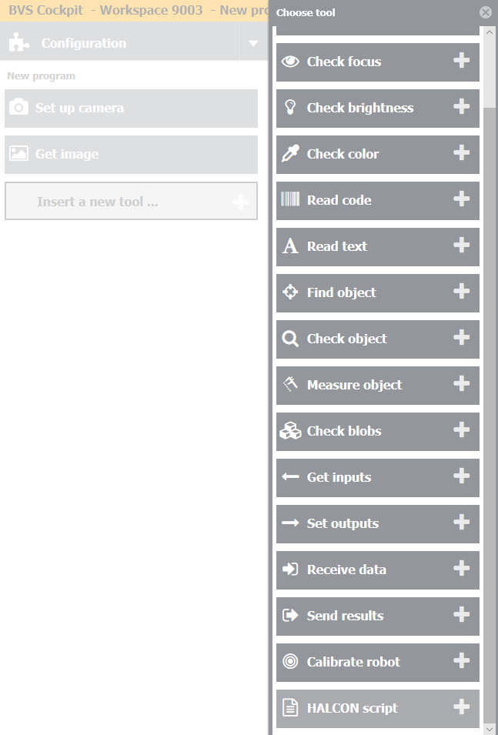
Step 1
Add new tool – Halcon Script – in your inspection program.

Slide 3
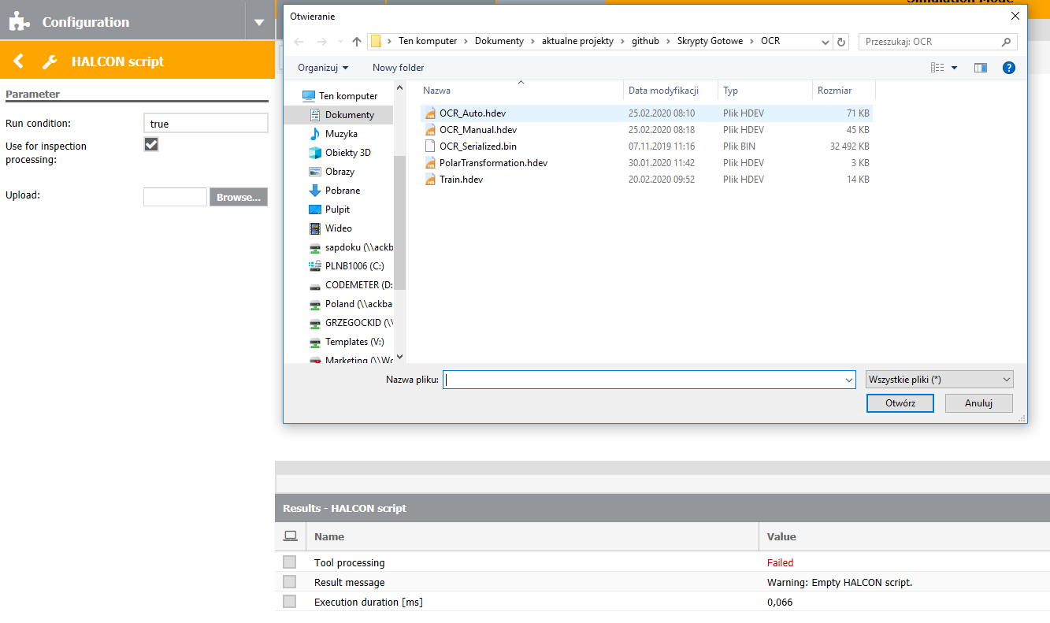
Step 2
Click „Browse” and choose „OCR_Auto.hdev” file.

Slide 4
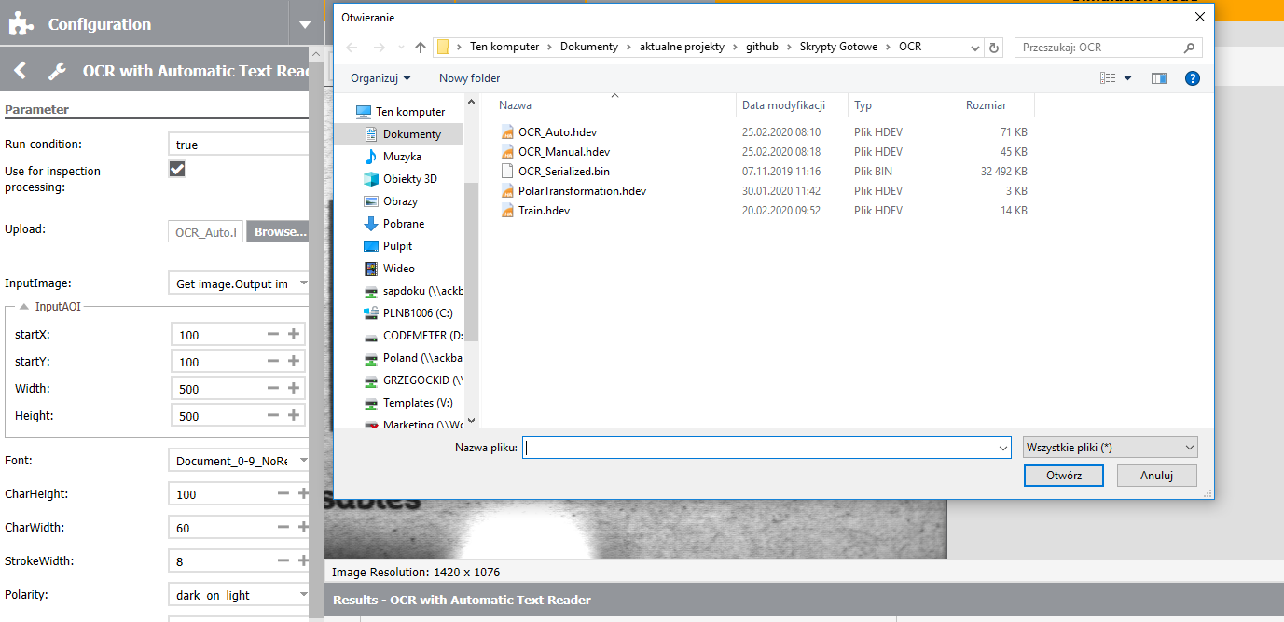
Step 3
Click „Browse” once again and choose „OCR_Serialized.bin” file.

Slide 5
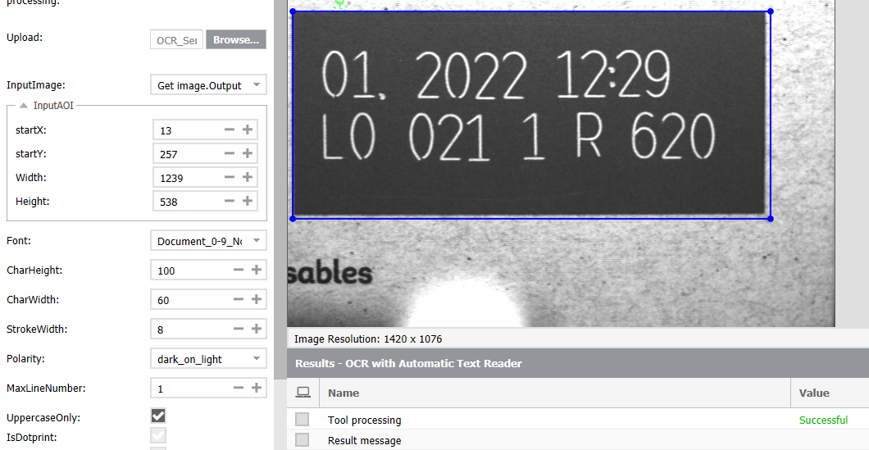
Step 4
Set the AOI to the characters that you want to read.

Slide 6
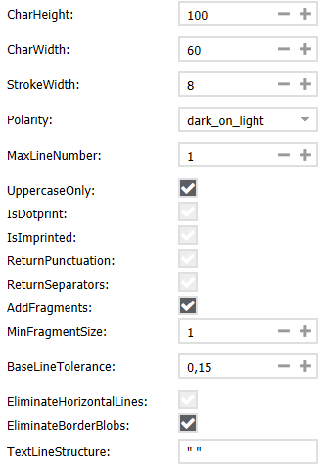
Step 5
Adjust parameters:
CharHeight – height of the characters (in pixels)
CharWidth – width of the characters (in pixels)
StrokeWidth – stroke width of the characters (in pixels)
Polarity – polarity of the characters
MaxLineNumber – number of text lines
UppercaseOnly – read only uppercase characters
IsDotprint – read dot-printed characters
IsImprinted – read imprinted characters
ReturnPunctuation – segment also punctuation marks
ReturnSeparators – segment also separators
AddFragments – segment also fragments (for example the dot on the „i”)
MinFragmentSize – minimum area of fragments
BaseLineTolerance – maximum base line deviation of the characters (in percent of CharHeight)
EliminateHorizontalLines – eliminate long horizontal structures close to the text
EliminateBorderBlobs – eliminate regions that are touching the border of the image domain

Slide 7

Step 5
Adjust parameters:
UseOrientation – automatically determines the orientation of text and aligns the image
UseSlant – automatically determines the slant of characters and aligns the image

Slide 8
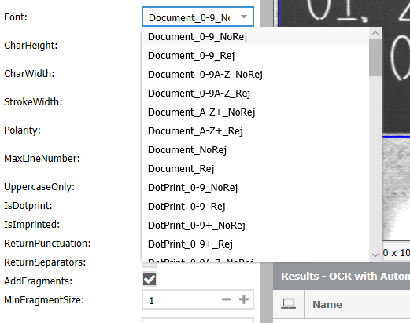
Step 6
Choose Font from drop-down list box.
If you want to use your trained font set Path in which new font was saved.
For BVS Cockpit PC version you can set any path you want (for example: "C:/Users/User/Desktop/„).
For BVS Cockpit in SVC you have to set path in “/data/icsServer/share/images/”
For BVS Cockpit in SC you have to set path in “../images/”
Be sure that the folder exists.
Be sure that there are no blank spaces in your path.
It’s better to type in the path in the box from scratch that copying it because it may cause various problems.
Click “Execute” on the right of “LoadFont” to load chosen font.

Slide 9
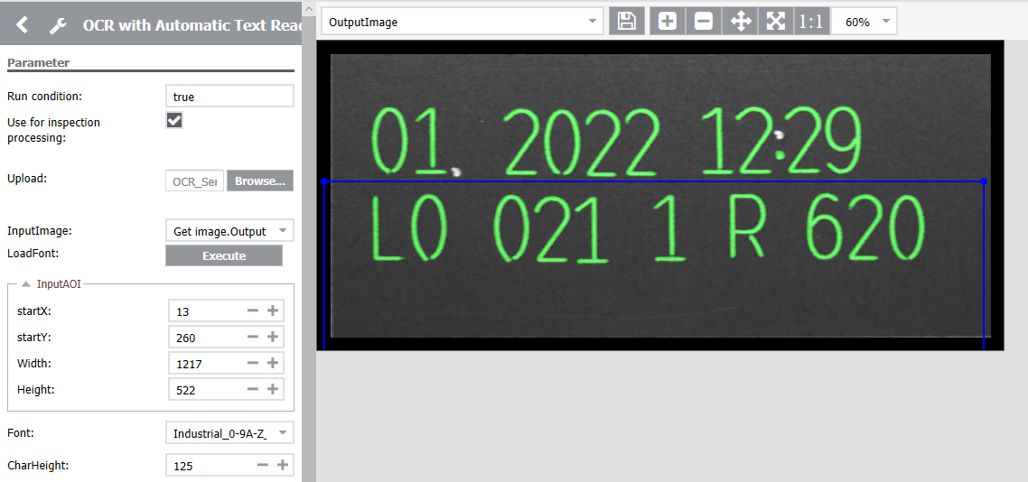
Step 6
Found text will be in OutputCharacters variable (as green regions) on OutputImage. Read characters will be in OutputString variable.

Slide 10
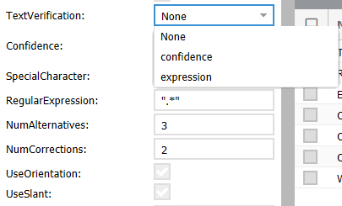
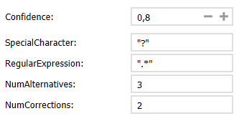
Step 7
There is also possibility to use verification method on the read characters. You can choose whether to use Confidence, Expression or None of them.
If you choose Confidence you can set following parameters:
Confidence – if the confidence (probability) of the character will be below this value SpecialCharacter will be displayed instead of read character
SpecialCharacter – special character which will replace character with low cofidence value
If you choose Expression you can set following parameters:
RegularExpression – word structure (for more details and examples refer to BVS Cockpit manual)
NumAlternatives – how many next (alternative/with lower confidence) characters will be taken into consideration if the character with best confidence does not match the regular expression
NumCorrections – how many corrections are possible
Read characters after Expression verification will be in Word variable.
If you choose None option all of the above parameters will not change anything.

